Slide 1
JIGSAW PUZZLE SOLVER
Team Zigvals
Prachi Agrawal 201401014
Akanksha Baranwal 201430015

Slide 2
AIM
The aim is to reconstruct the original image from a set of non-overlapping, unordered, square puzzle parts. Multiple puzzles mixed into one and puzzles with up to 30% missing pieces can be handled.

Slide 3
SCOPE
Following cases have been handled:
Single image puzzles with very less variations in patch
Single image puzzles with some constant intensity patches
Puzzles with missing pieces
Puzzle may be a mix of puzzles from different puzzles

Slide 4

APPLICATIONS
Assembly and repair are the major robotics application tasks. This can be posed as a jigsaw puzzle assembly problem.
The problem of multiple puzzles mixed into one is similar to restoring archaeological findings. For example when torn documents or broken artifacts are found mixed and lack parts.

Slide 5
ASSUMPTIONS
Testing has been done on images multiple 512x512 images.
The size of the puzzle pieces has been taken to be 64x64.
All puzzle pieces are square in shape.
The algorithm can be extended to similar square pieces puzzles.

Slide 6

DEVELOPMENT OF SOLUTION

Slide 7
Steps
1. Conversion of input image from RGB space to Lab space In a jigsaw puzzle it is important to keep similar pieces together, similarity would be better measured in Lab space rather than in RGB space.

Slide 8
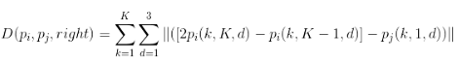
Steps
2. Constructing the dissimilarity matrix using the 'dissimilarity' function
K - piece size,
d - dimension in the LAB color space (all 3 spaces are combined together and added) p_{i}, p_{j} - two pieces between which dissimilarity is being calculated

Slide 9
The dissimilarity between every pair of pieces in right direction is being calculated by considering the last 2 columns of the first piece and the first column of the second piece
Asymmetric dissimilarity (that is, D(p_{i}, p_{j}, right) = D(p_{j}, p_{i}, left)) has been used.
Important when the puzzles have missing pieces as it helps in placing the border pieces.
Computationally most expensive step O(4mn)

Slide 10
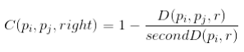
Steps
3. Constructing the compatibility matrix using the 'dissimilarity' function
secondD(p_{i} , r) is the value of the second best dissimilarity of piece p i to all other pieces with relation r.
D(p_{i} , r) is the value of the best dissimilarity of piece p i to all other pieces with relation r.
r -> {up, down, left, right}

Slide 11
A small dissimilarity between two pieces may not always be a reliable metric to conclude adjacency (smooth regions).
Need to consider closest as well as second closest neighbor.
If relative dissimilarity between the closest and second closest neighbor differs, then that piece is more likely to be the neighbor.
This has an effect of normalization.

Slide 12
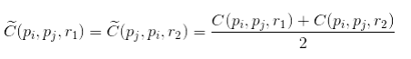
Steps
4. Calculating the mutual compatibility
relation r₂ is the opposite of relation r₁
An average of the compatibilities in corresponding complementary directions proves to be a useful metric to find a piece with the strongest neighbors in all spatial directions
Best buddies metric Two pieces are best buddies if both agree that the other piece is their best neighbor in the corresponding spatial direction.

Slide 13
Steps
5. Placing

Slide 14
Naive Approach

Slide 15
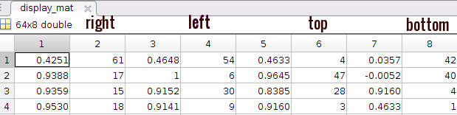
NAIVE APPROACH
Calculation of display_mat (store of best buddies for every piece) using compatibility function
Mutual compatibility not yet calculated.
Current piece --->

Slide 16
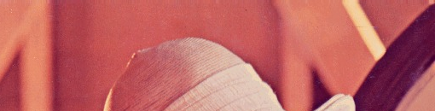
NAIVE APPROACH
Depending upon whether we get best buddies continuously, we kept on adding pieces to form rows from left to right.

Slide 17
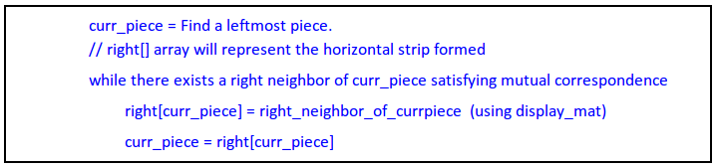
NAIVE APPROACH
For the placement of the pieces, horizontal strips are constructed first using the below algorithm followed by their vertical placement.

Slide 18
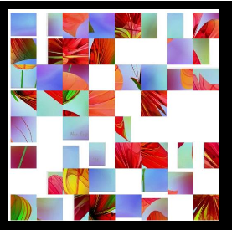
NAIVE APPROACH
Input image

Slide 19
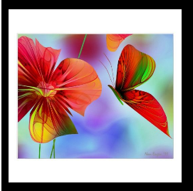
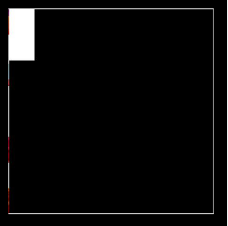
NAIVE APPROACH
Expected Output Actual Output

Slide 20

The above solver doesn't handle the pieces lying in the constant intensity patch region.
It is not able to handle puzzles with missing pieces.
The complexity of this approach is O(mn).

Slide 21
Involvement of mutual compatibility

Slide 22
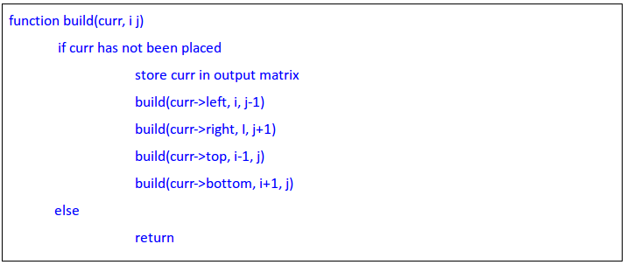
Involvement of mutual compatibility
Calculation of display_mat using mutual compatibility function.
Relative position of all pieces is being stored in both horizontal and vertical directions.
Recursive placement of pieces in their relative positions for all the pieces at once.

Slide 23
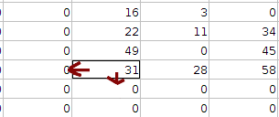
Involvement of mutual compatibility
Intermediate step in recursive placement of pieces

Slide 24
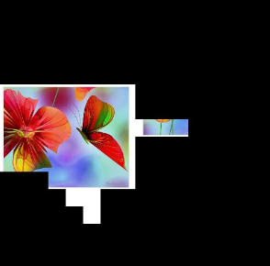
Involvement of mutual compatibility
Improvement from the naive approach

Slide 25
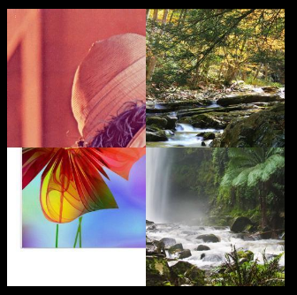
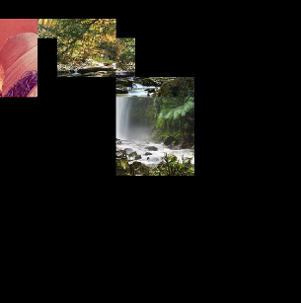
Involvement of mutual compatibility
????????
Expected Output Actual Output

Slide 26
The more uncertain pieces(pieces whose best buddies are not yet placed) might get placed in the very starting phase of reconstruction, thus leading to erroneous results.
Most prominent in puzzles with mixed image puzzles as it gets confused at the border of these subimages.
The complexity of this approach is O(mn).

Slide 27
On Fly Placement

Slide 28
On Fly Placement
The difference with the previous method is that now we are fixing the positions in the order of best pieces as and when they come. So the likelihood of a piece being placed at the wrong place is very less.

Slide 29
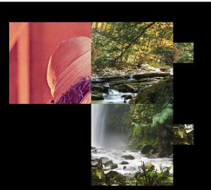
On Fly Placement
Expected Output Actual Output

Slide 30
while calculating the relative positions, the addresses returned by different best buddies sometimes came out to be different.

Slide 31
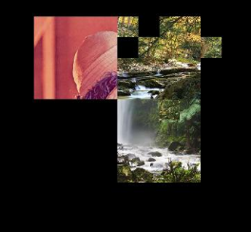
On Fly Placement
Result obtained after handling the “multiple” positions issue by allowing a piece to be placed at-most once

Slide 32
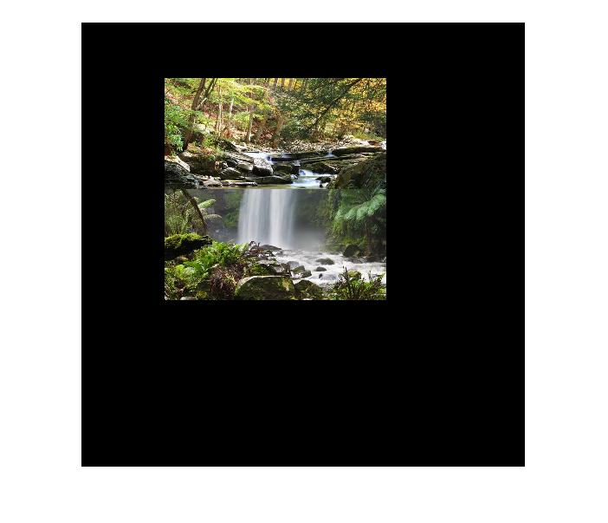
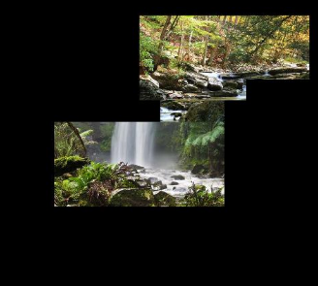
On Fly Placement
Expected Output Actual Output

Slide 33
The corner and the border pieces involving multiple images puzzle was mismatching the best buddies if it was not able to find any neighbour.

Slide 34
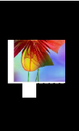
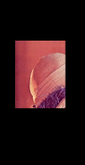
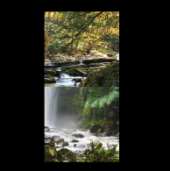
On Fly Placement
We observed that in the cases with the previous problem, the value of the mutual compatibility was particularly very low. So this was handled by setting proper threshold while returning best buddies of the best piece.

Slide 35
Steps
5. Finding the best piece
Using the display_mat, we search for a piece that has best buddies in all four directions.
The more distinctive such a piece is, the better will the coming pieces be placed relative to this piece.
The metric for deciding this has been calculated by adding up the mutual compatibility values of best buddies in corresponding directions.

Slide 36
Steps
6. Placing the other consecutive pieces
A pool is maintained that consists of those pieces whose neighbors were strong pieces and have already been placed.
The next piece(best piece) to be placed is taken from this pool, and the best buddies of this best piece are inserted into the pool.
A threshold value for the compatibility with the best buddies is also taken.
The best piece selected is such that the sum of the mutual compatibilities (with its closest neighbors) is maximum.

Slide 37
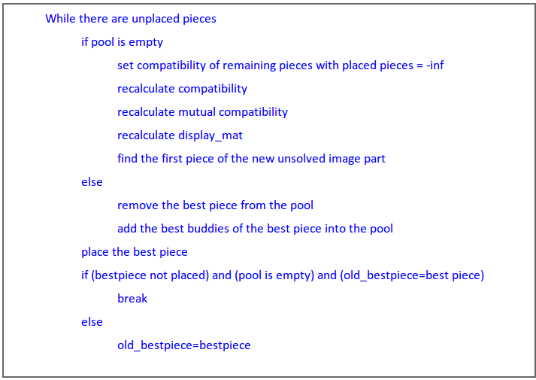
Base algorithm

Slide 38
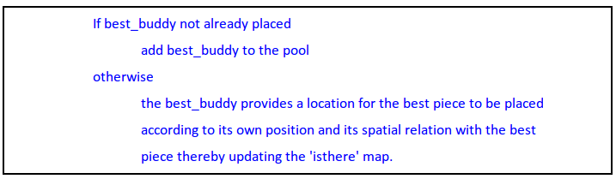
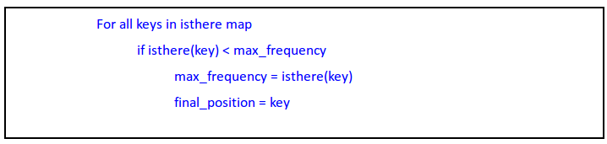
Operation on best buddies & isthere map

Slide 39
FINAL RESULTS

Slide 40
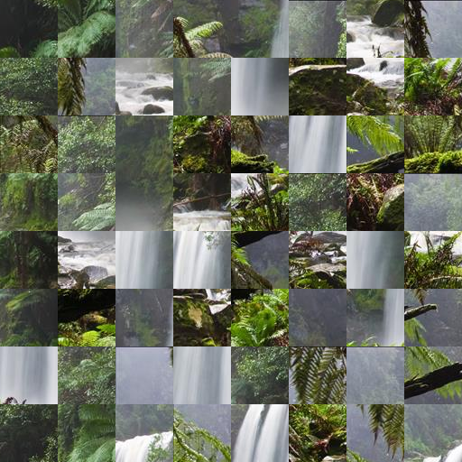
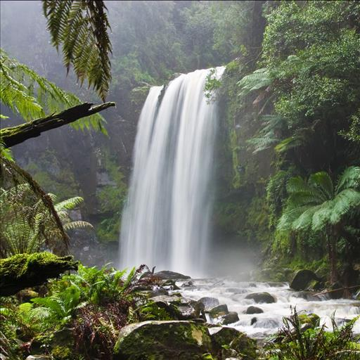
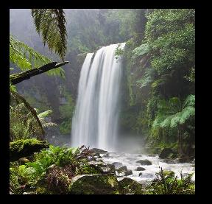
Single images
Solved image
Original image
Input puzzle

Slide 41
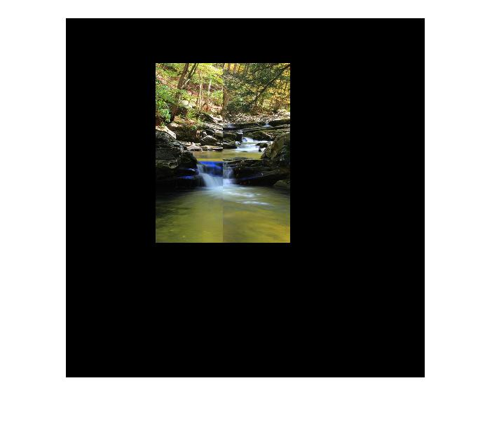
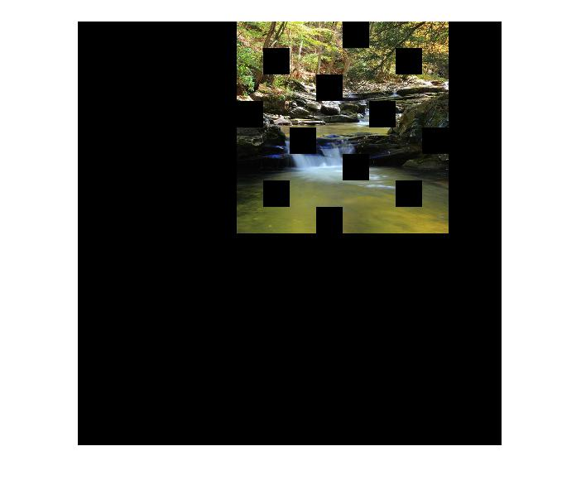
Missing pieces
Puzzle with 1/5th pieces missing
Puzzle with 1/4th pieces missing

Slide 42
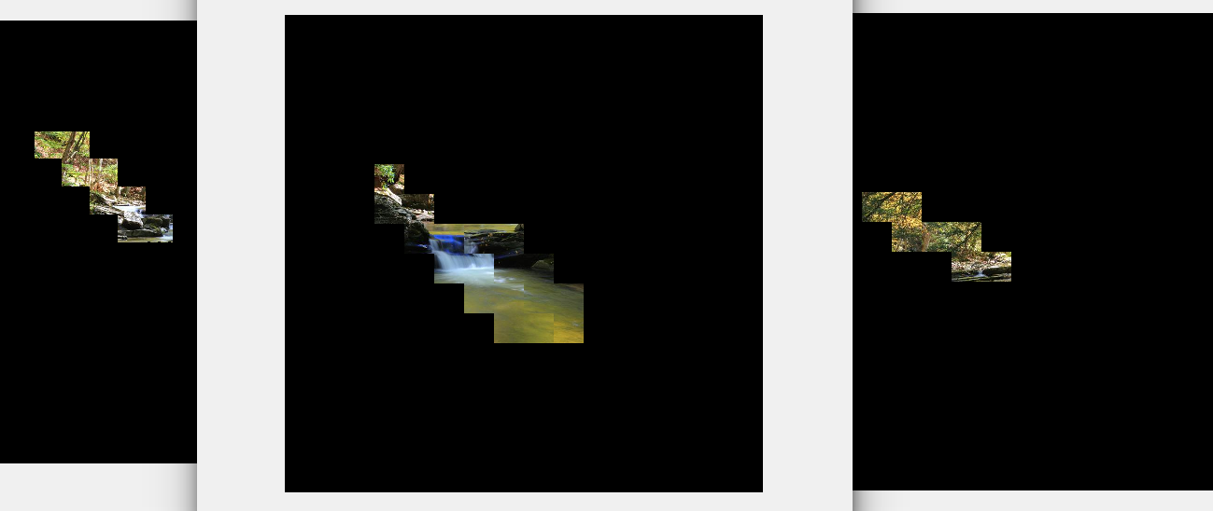
Missing pieces
Puzzle with 1/3rd pieces missing

Slide 43
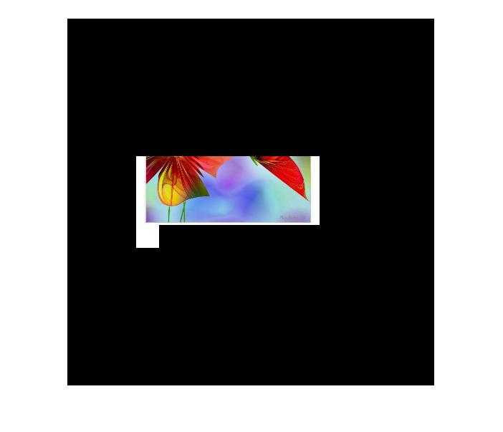
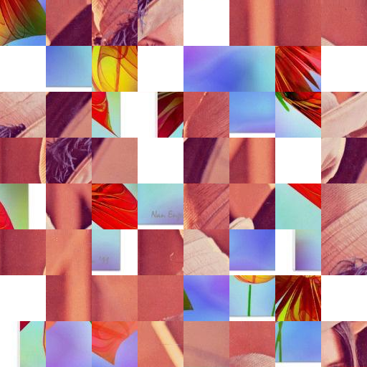
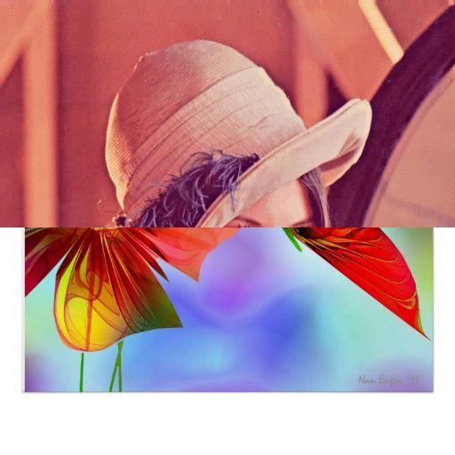
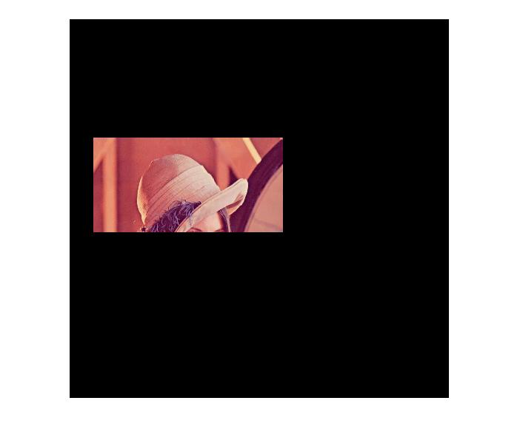
Multiple puzzles in one
Original image
Input puzzle
Solved images

Slide 44
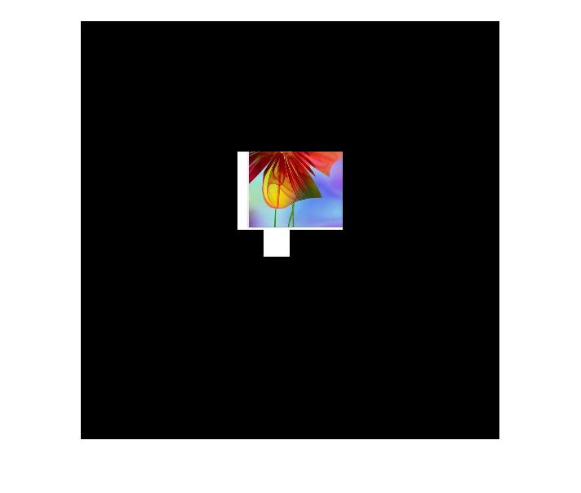
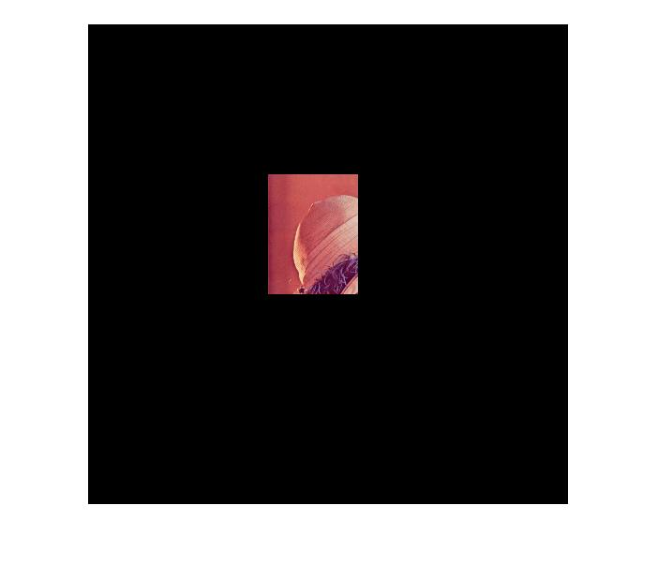
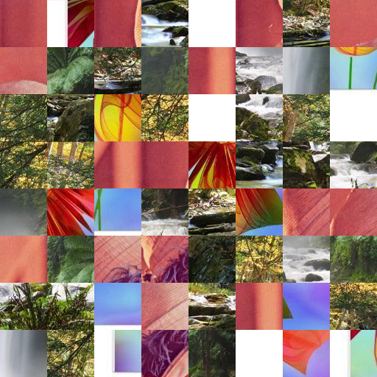
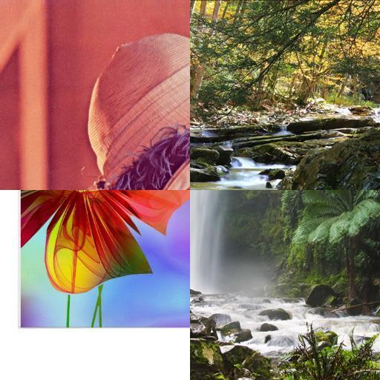
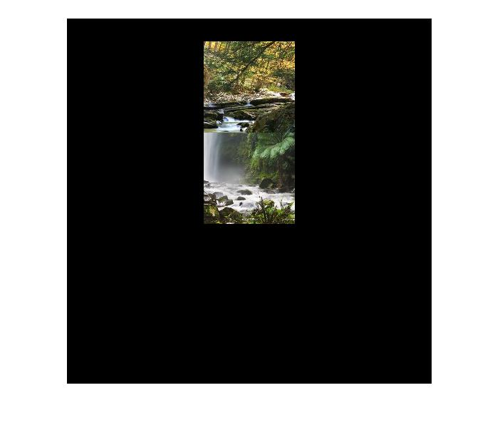
Multiple puzzles in one
Output images
Input puzzle
Original image

Slide 45
CHALLENGES & LIMITATIONS

Slide 46
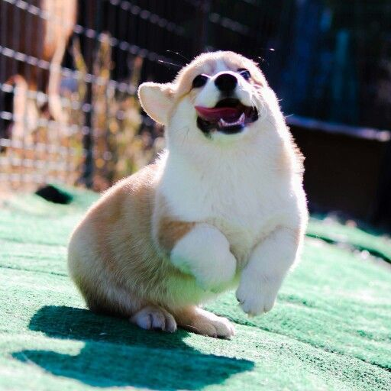
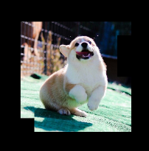
The algorithm has a high complexity, working with large number of puzzle pieces is difficult.
We were not able to efficiently handle puzzles having constant intensity patches.

Slide 47

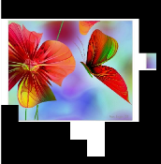

Slide 48
REFERENCES

Slide 49
Genady Paikin and Ayellet Tal. Solving multiple square jigsaw puzzles with missing pieces. In Computer Vision and Pattern Recognition (CVPR), 2015 IEEE Conference.
Code for generating the puzzle pieces taken from: https://www.cs.bgu.ac.il/~icvl/icvl_projects/automatic-jigsaw-puzzle-solving/

Slide 50
THANK YOU

